Slide 1
Adding Color in CSS
Text Color :-
color: red;
color: #FF5733;
color: rgb(255, 0, 0);
color: rgba(255, 0, 0, 0.5);
Background Color :-
background-color: lightblue;

Slide 2
CSS Units
Units define sizes, spacing, and lengths in CSS. Two main types:
Absolute Units:
px (pixels)
cm, mm (centimeters, millimeters)
pt (points) = 1/72 of an inch
Relative Units:
% (percentage of parent size)
em (relative to font-size of current element)
rem (relative to font-size of root element)
vw, vh (viewport width and height)

Slide 3
Border to an Element
Adding border:-
border-width: 2px;
border-style: dashed; (none, solid, dashed, dotted, double)
border-color: red;
Shorthand for Border:-
border: 2px solid blue;
Rounded corners:-
border-radius: 8px;

Slide 4
Text Styling
font-family: specifies font type
font-size: controls size
font-weight: normal, bold, numeric (100-900)
text-align: left, center, right, justify
text-decoration: underline, line-through, none
text-transform: uppercase, lowercase, capitalize

Slide 5
Adding background to an element
Color: background-color: #f0f0f0;
Image: background-image: url('background.jpg');
background-repeat: no-repeat;
background-size: cover;
background-position: center;

Slide 6
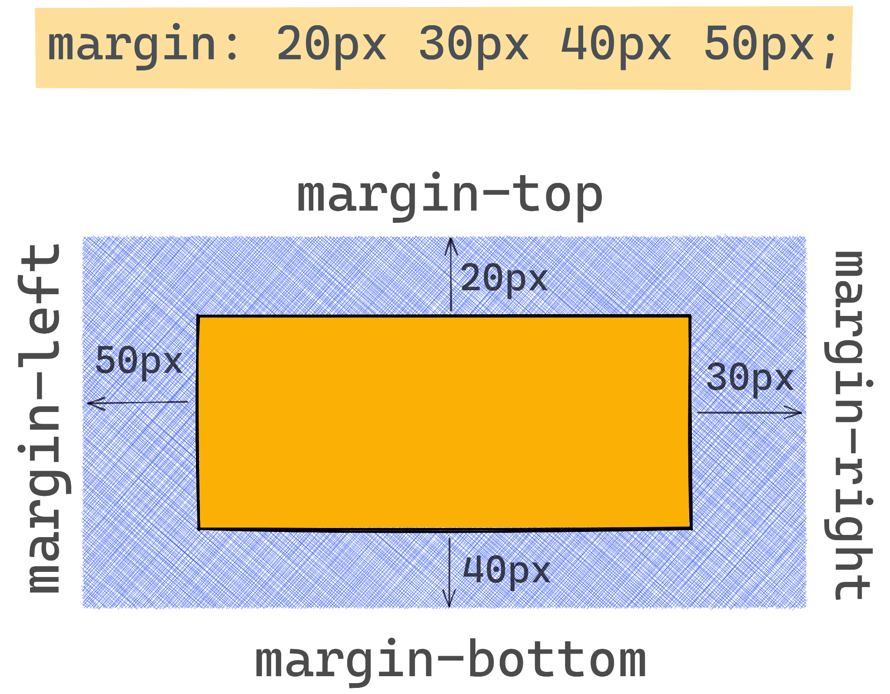
Margins
Syntax :-
margin-top : value;
margin-bottom : value;
margin-left : value;
margin-right : value;

Slide 7
Margin Shorthand
margin: value (All four sides)
margin: value(Top & bottom) value(Left & right);
margin : value(top) value(Left & right) value(bottom);
margin : value(top) value(right) value(bottom) value(left);

Slide 8
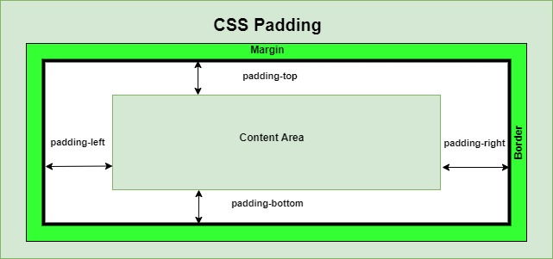
Paddings
Syntax:-
padding-top : value;
padding-bottom : value;
padding-left : value;
padding-right : value;

Slide 9
Padding Shorthand
padding : value (All four sides)
padding : value(Top & bottom) value(Left & right);
padding : value(top) value(Left & right) value(bottom);
padding : value(top) value(right) value(bottom) value(left);

Slide 10
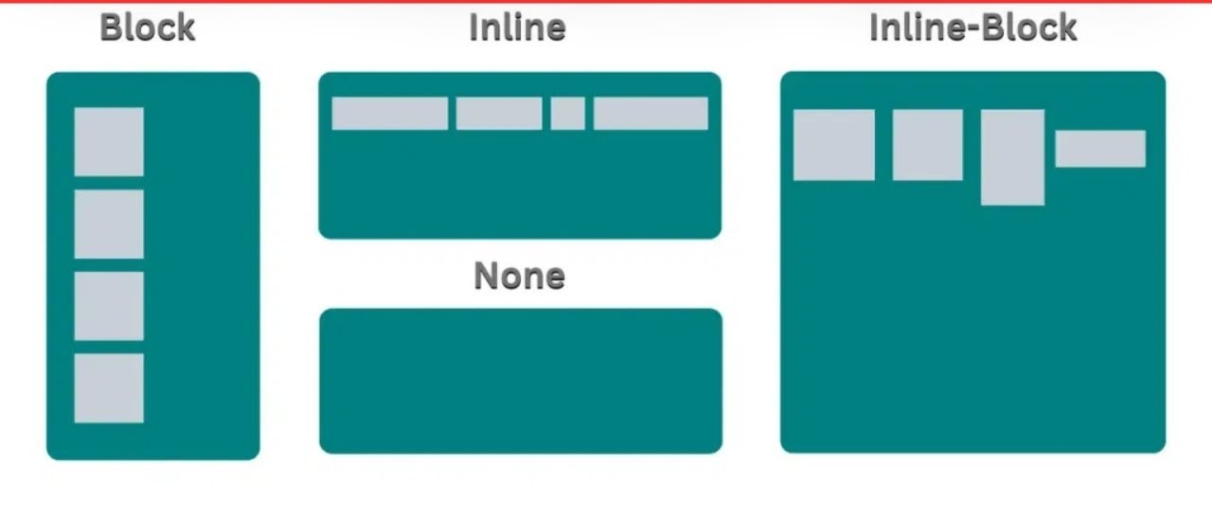
Display Property

Slide 11
Display Property
Syntax :
display : inline / inline-block / block / none;
block elements stack vertically.
inline elements flow horizontally.
inline-block combines features of both.
none removes element from layout completely.

Slide 12
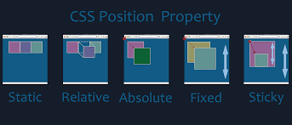
Position Property
The position property specifies how an element is positioned in the document.

Slide 13
Position Property Values
Static :-
Elements flow naturally as per the HTML structure.
top, left, etc. have no effect.
Relative :-
Positioned relative to its normal place.
You can use top, left, right, bottom to nudge the element without affecting surrounding elements.
Space for the element remains reserved in the document flow.

Slide 14
Position Property Values
Absolute :-
Element is taken out of the normal flow.
Positioned relative to the nearest positioned ancestor (position not static).
If no positioned ancestor, positioned relative to the <html> or viewport.
Other elements behave like it’s not there (no space reserved).
Use top, left, right, bottom to place exactly.

Slide 15
Position Property Values
Sticky :-
Positioned relative to the viewport (browser window).
Element stays fixed on the screen even when scrolling.
Often used for sticky headers, menus, or back-to-top buttons.
Fixed :-
Hybrid of relative and fixed.
Acts like relative until scrolling reaches a threshold, then becomes fixed.
Useful for headers or menus that stick after scrolling past them.

Slide 16
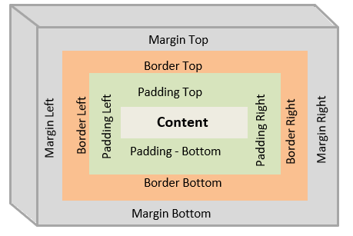
Box model

Slide 17
Box model
Content: The area where text or other content is displayed.
Padding: Space between the content and the element's border.
Border: A frame that wraps around the padding and content.
Margin: Space between the element's border and neighbouring elements.

Slide 18
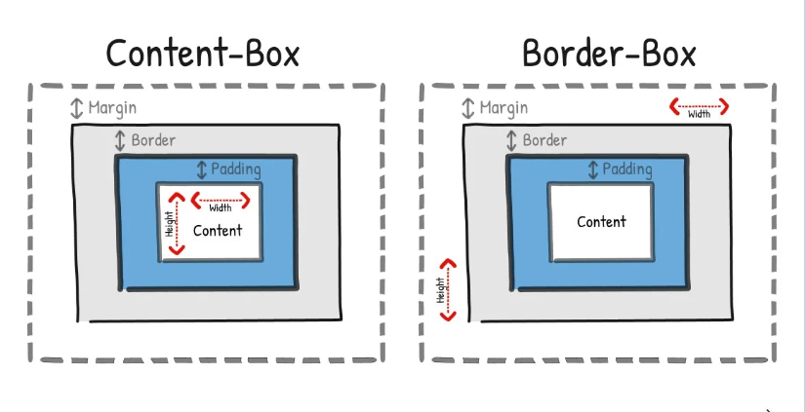
Box Sizing Property in CSS

Slide 19
Box Sizing Property in CSS
1. Content-Box(default property)
Width and height apply only to the content area.
Padding and border are added outside the set width/height.
Total element size = content + padding + border.
If you set width: 200px and add padding: 20px and border: 5px, total width = 200 + 20*2 + 5*2 = 250px.
Good when you need content size to be exact and don’t mind total size increasing

Slide 20
Box Sizing Property in CSS
2. Border-Box
Width and height include content + padding + border.
The set width/height is the final total size of the element.
Content area shrinks automatically to accommodate padding and border.
If you set width: 200px and add padding: 20px and border: 5px, total width stays 200px, content width = 200 - 20*2 - 5*2 = 150px.
Easier for responsive layouts since padding/border won’t increase overall size.

Slide 21
Min-width and Max-width
Min- width :-
Sets the minimum width an element can shrink to.
The element will not get smaller than this value.
Syntax: min-width: value’;
Max- width :-
Sets the maximum width an element can grow to.
The element won’t stretch beyond this width, even if there is space.
Syntax : max-width : value;

